Slide 1

Measure and columns
In Power BI, measures and columns are fundamental components used for creating data models and visualizations. While they both deal with data, they serve different purposes and have distinct characteristics

Slide 2
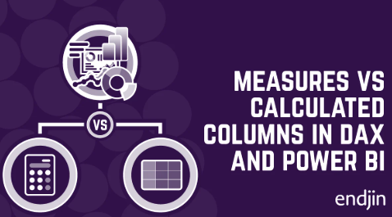
Column
Columns are the fields in a table that store raw or precomputed data. They can come directly from a data source or be created as calculated columns within Power BI.

Slide 3
Key Characteristics:
Static Data: Each cell in a column has a value, similar to a field in an
Excel table.
Storage: Stored as part of the data model, meaning they increase the file size.
Row Context: Calculated columns operate row by row in a table, often using functions
like RELATED or IF to define values.
Data Sources: Can be directly imported or calculated using
DAX (Data Analysis Expressions).

Slide 4
Example
Suppose you have a "Sales" table with columns:
Product Name
Quantity Sold
Unit Price
You might create a calculated column using DAX like:
Total Price = Sales[Quantity Sold] * Sales[Unit Price]
This new column stores the total price for each row in the table.
Use Case:
When you need row-by-row computations.
When the data will be reused in multiple calculations or visualizations

Slide 5
Measure
Measures are calculations that are performed dynamically based on the data context (e.g., filters applied in visuals).

Slide 6
Key Characteristics:
Dynamic Calculation: Values are computed on the fly, depending on user interactions and filters applied in reports.
No Storage: Measures do not occupy additional space in the data model.
Filter Context: Measures calculate based on the current context of rows, columns, filters, or slicers in a visualization.
DAX Required: Always defined using DAX

Slide 7
Example
DAX
Total Sales = SUM(Sales[Total Price])
This measure calculates the total sales across all rows but dynamically
changes when filters (e.g., by product or region) are applied.
Use Case:
Aggregate or summary calculations, like totals, averages, or percentages

Slide 8
Data Analysis Expressions (DAX)
A DAX query refers to a Data Analysis Expressions (DAX) formula or expression used within Power BI, Excel, or other Microsoft tools to perform data analysis and create calculations in a data model.
DAX is a formula language designed specifically for working with data in these tools, and it is used to create measures, calculated columns, calculated tables, and queries in Power B

